Slide 1



Elevate Labs
Data Analyst Intern
TASK 4
Presented by,
Arihant Jain

Slide 2

C O N T E N T S
Objective
Overview
Data Dictionary
Dashboard
Business Insights

Slide 3
Objective
Design an interactive dashboard for business stakeholders.
Tools: Power BI

Slide 4
overview
Right KPIs (Sales, Profit, Growth)
Use slicers/filters for interactivity c
Include time-series analysis
Add cards for totals/summary e
Apply consistent color theme f
Create navigation menu (if possible)

Slide 5
Data Dictionary
Order Metadata
Row ID: A unique identifier for each row in the dataset (often used for indexing).
Order ID: A unique identifier for each order. Multiple rows can share the same Order ID if multiple products were ordered together
Order Date: The date when the customer placed the order.
Ship Date: The date when the order was shipped.
Ship Mode: The shipping method used (e.g., Standard Class, Second Class, Same Day, etc.).

Slide 6
Customer Information
Customer ID: A unique identifier for each customer.
Customer Name: The full name of the customer.
Segment: The type of customer (e.g., Consumer, Corporate, Home Office).
Product Information
Product ID: A unique identifier for each product.
Category: Broad classification of the product (e.g., Furniture, Office Supplies, Technology).
Sub-Category: A more specific classification within the category (e.g., Chairs, Binders, Phones).
Product Name: The name of the product.

Slide 7
Geographical Details
Country: The country where the order was shipped.
City: The city where the order was shipped.
State: The state or province where the order was shipped.
Postal Code: The postal/ZIP code of the shipping address.
Region: The region the location belongs to (e.g., East, West, Central, South in the US).
Sales Metrics
Sales: Total sales amount for the product in that row.
Quantity: Number of units of the product sold in that order.
Discount: The discount applied to that item (represented as a decimal, e.g., 0.2 for 20%).
Profit: The profit made from selling the product after subtracting cost and discount.

Slide 8
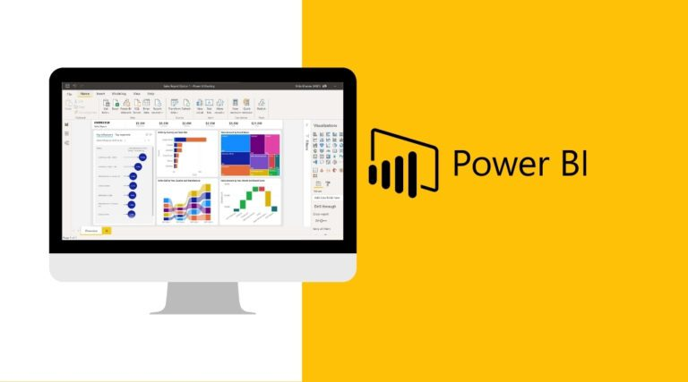
Process Making Dashboard in power BI

Slide 9

Load the data
Data Cleaning & Preparation
Create Relationships (if multiple tables)
Create Dax Measures
Format the Dashboard
Build Visualizations

Slide 10
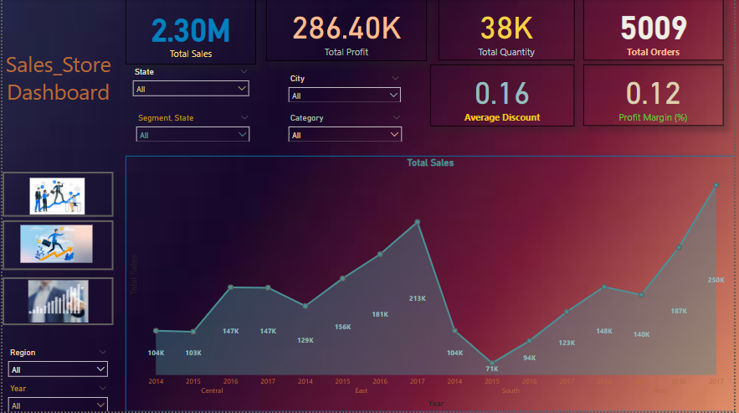
Data Visualization

Slide 11
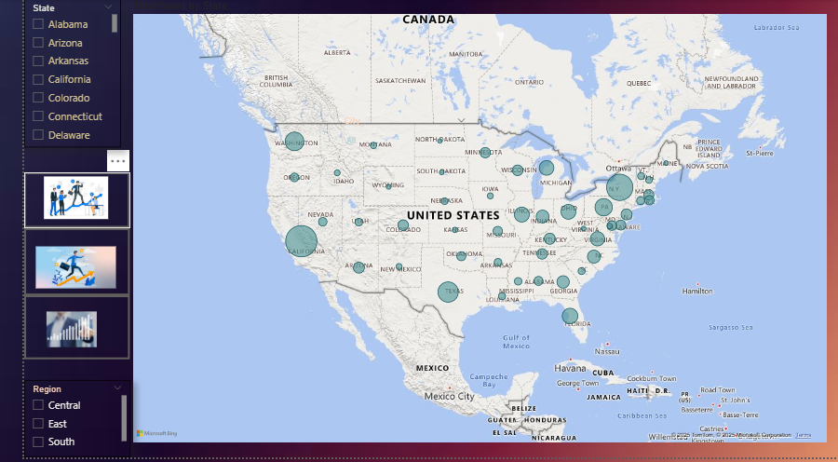

Slide 12
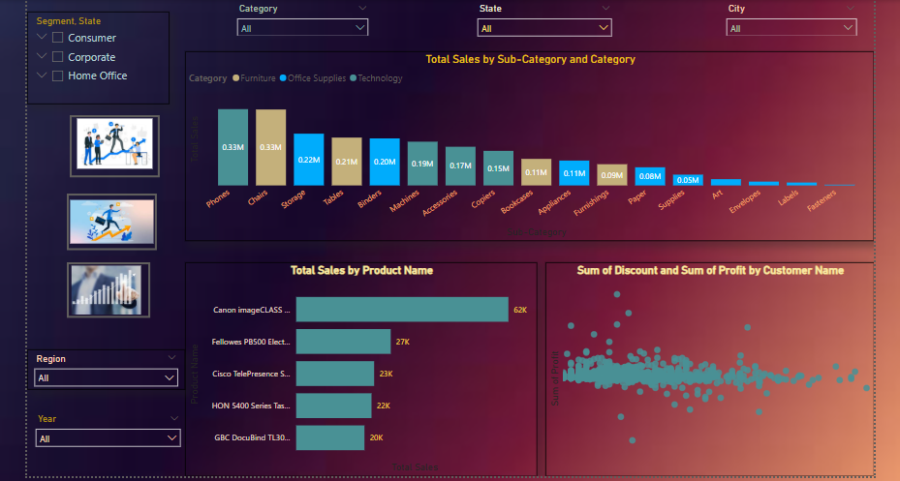

Slide 13
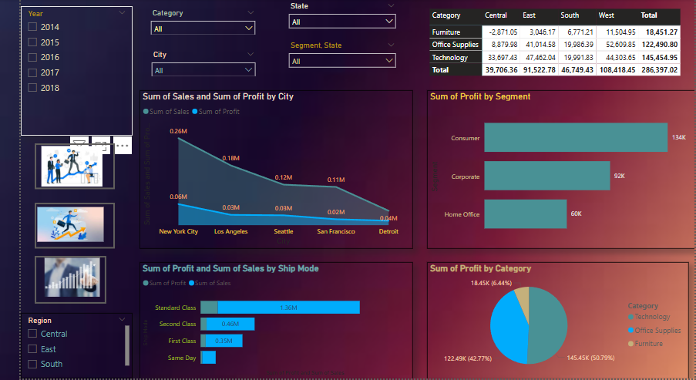

Slide 14
Executive Summary of Dashboard Insights
Overall Business Performance
The organization has achieved a strong sales performance, with total sales revenue and net profit indicating healthy financial growth.
Despite consistent revenue generation, profitability is impacted in certain product categories due to high discounting and shipping costs.

Slide 15
Regional Analysis
The East region emerged as the top-performing region in terms of both sales and profit, driven by strong customer engagement and product demand.
In contrast, the Central region recorded lower profitability, signaling potential areas for cost optimization or marketing focus.
Customer Segmentation
The Corporate segment generated the highest sales, reflecting its substantial purchasing power.
The Home Office segment, however, yielded the highest profit margins, attributed to lower discounts and cost-effective order fulfillment.
The Consumer segment remains the largest in terms of order volume, highlighting its importance in maintaining consistent cash flow.

Slide 16
Product & Category Insights
The Technology category dominates overall sales, especially due to high-performing sub-categories such as Phones and Accessories.
Copiers stand out as the most profitable sub-category, contributing significantly to the bottom line.
Conversely, Tables and Bookcases are underperforming, with low or negative profit margins, likely influenced by deep discounts and high delivery costs.
Time-Based Trends
Sales peaks are observed in Q4, particularly in November and December, indicating strong holiday season performance.
Sales slow down during mid-year months, such as July and August, suggesting a seasonal dip that may benefit from promotional strategies.
Year-over-year trends demonstrate a positive growth trajectory, supporting the effectiveness of current business strategies.

Slide 17

THANK YOU
ARIHANT JAIN
jainarihant0102@gmail.com

